Slide 1
By the end of this lecture you will
Recognise that Laravel uses the Inversion of Control principle
01
Have a basic understanding of the middleware pipeline
02
Understand how routing works within Laravel
03

Slide 2
Before we start: last lecture checklist
Follow the documentation https://laravel.com/docs/9.x
Install Docker Desktop
Install WSL2 and a Linux Distro if working on Windows
Install Visual Studio Code
Install Laravel
Create a GitHub account and upload your branch to github – video on Canvas
Start Sail – Open a browser and check it is working!
(also you probably want to make a sail alias in your Ubuntu distro)

Slide 3
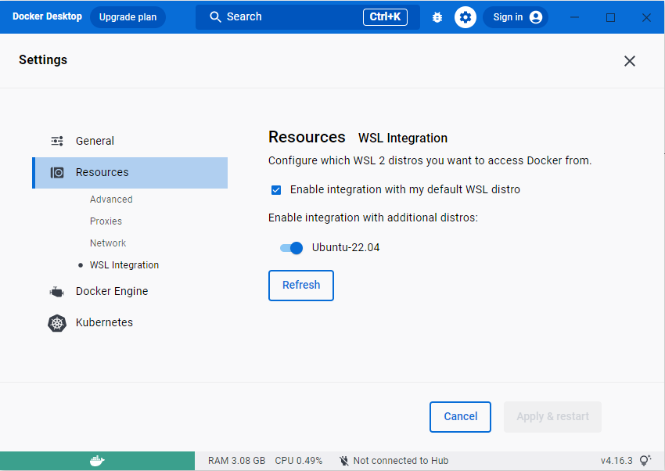
Before we start: Docker settings
Starting the app
Start Docker
Check docker’s settings
Start Sail

Slide 4
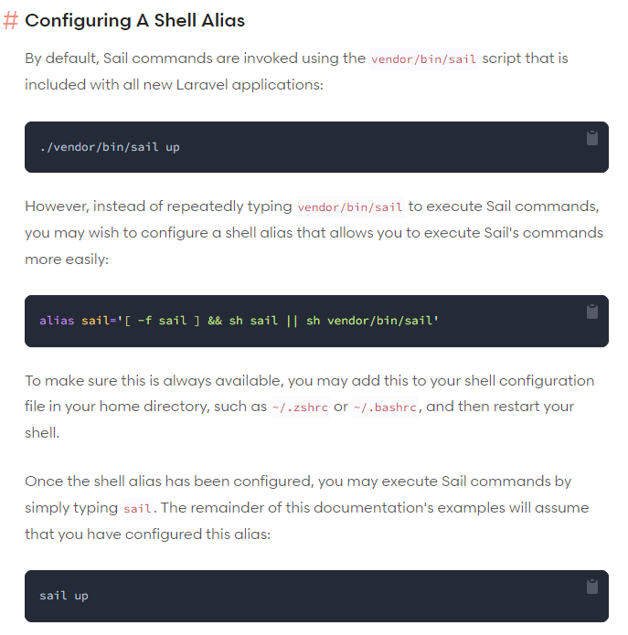
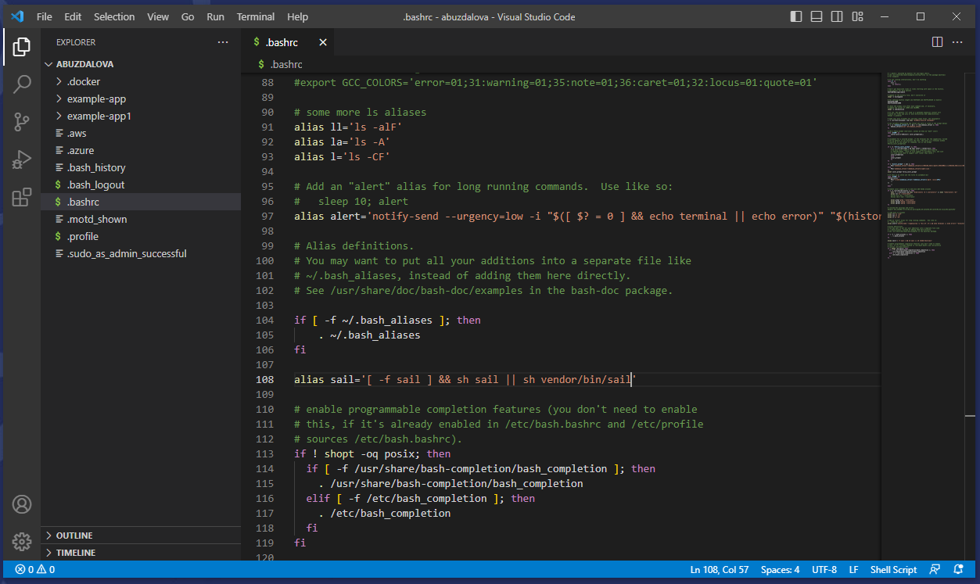
Before we start: Sail alias

Slide 5
Inversion of Control
An important concept to understand when working with frameworks (in any area)

Slide 6
When you aren’t using a framework most of the work done by the application is code you have written
You might need to use some libraries to do specific things like render something on the screen
Your code is controlling the flow of the application, asks the library to do a job then takes back control
Your Code
Library
Library

Slide 7
When you use a framework, it is the framework which is doing most of the work
The framework allows you to write code which slots in somewhere
The framework controls the flow of the application, asks your code to do something, then takes back control
This is Inversion of Control
Learning a framework is about understanding where your code hooks into it
Framework
Your Code

Slide 8
The Request Lifecycle in Laravel
Laravel is an excellent framework to learn with because every project has the uncompiled framework in it which you can just look at
Nothing happens magically, nothing is hidden in dlls, if you want to understand how something works you just look at it.
Also the documentation is incredible!
Lets look at the request lifecyle – how an HTTP request is processed by an application to create an HTTP response

Slide 9
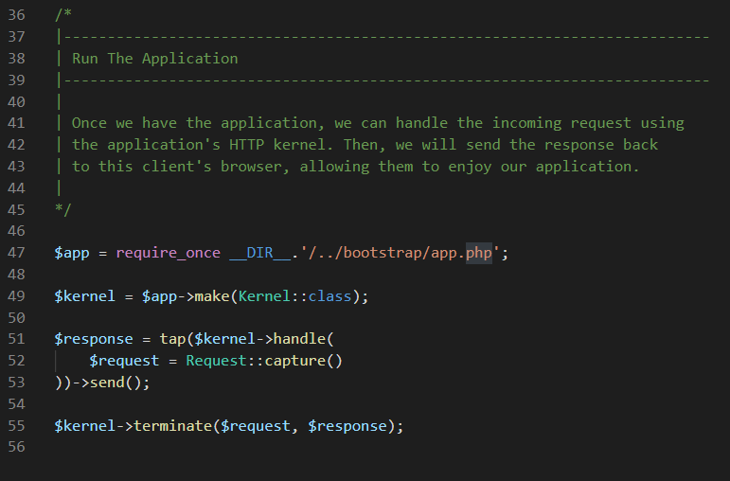
The entry point to the application is index.php in the public folder – lets look at the end of the file
Creates an instance of the Laravel application – an object called $app
The incoming request is sent into the kernel which can be thought of a black box which defines your entire application. The kernel then outputs a response.
Crucially the kernel defines a list of middleware we call the middleware pipeline.

Slide 10

The Middleware Pipeline

Slide 11
Response
Request
-> URI
-> Data
Routing
Authentication
Controller
Middleware Pipeline (the above are just examples)
A request enters the middleware pipeline and is passed along until one of the middleware packages creates a response.
If a request gets all the way through the pipeline with no request generated an error is sent to the user.

Slide 12
Response
‘Access Denied’
Request
‘/admin/secret’
Routing
Authentication
Controller
Middleware Pipeline (the above are just examples)
For example, if you request a URI you are not authorized for your request will get as far as authentication then a ‘Access Denied’ response will be created and sent back to you.
…or it might pass the request on to a ‘login’ controller which gives a ‘please login’ type response.

Slide 13
Routing

Slide 14
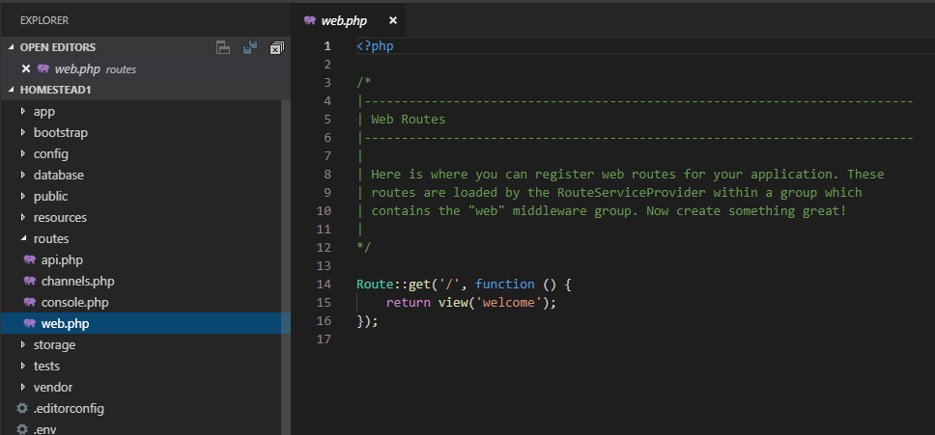
Laravel Routing
The key method for a browser to communicate with your application is through routes
Each path we want to exist in our web application can be thought of as a route. We must tell Laravel what to do for each route.
These are defined in the routes folder of a Laravel project

Slide 15

The PHP class which has all the route related methods
The HTTP verb for this route
The function to be called when a user navigates to this route
The route or path

Slide 16
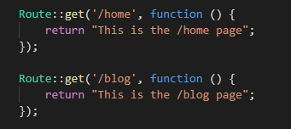

Slide 17
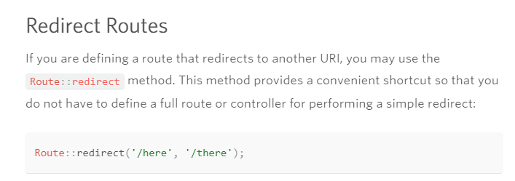

Slide 18

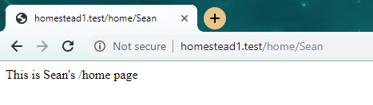
We can create routes which accept parameters as well…
These parameters are required, to make them optional we need to do more work…

Slide 19
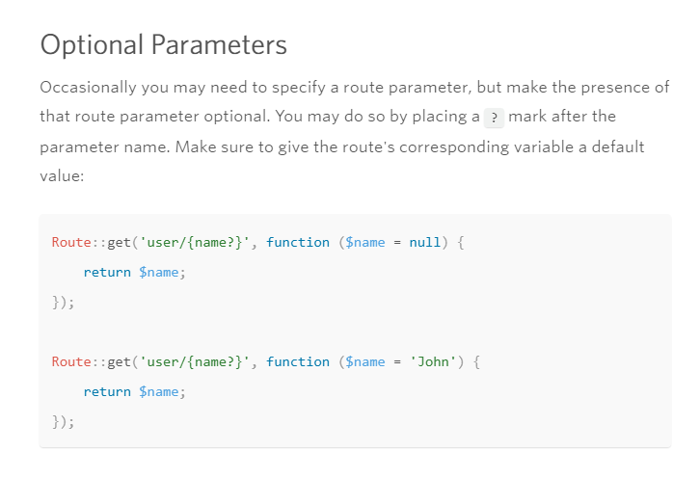

Slide 20
Artisan
Artisan is a tool Laravel provides to do lots of useful testing and scaffolding
It is literally a PHP file in your Laravel project directory – so you can see how it works
To run this in your sail docker run ./vendor/bin/sail artisan <arguments>
For example type ./vendor/bin/sail artisan list to see all the commands available
This needs to be done in your Laravel project folder!
In all my notes and all the documentation the sail command won’t be included, you need to remember to add that.

Slide 21
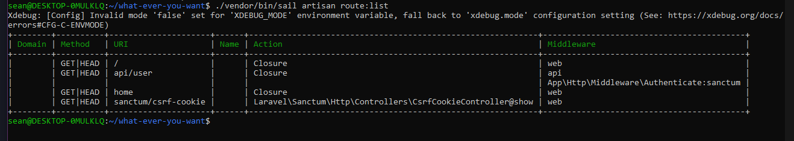
Using Artisan to List Routes
artisan route:list will list all the routes defined in your web app. A really good way to check things are defined correctly!

